Slide 1

HKState-NUCA A Searching Mechanism for Dynamic NUCA in Chip Multiprocessors
Department Of Computer Science And Engineering
Indian Institute Of Technology Guwahati
M.Tech Thesis Presentation
Supervisor
Dr. Hemangee K Kapoor
Presented by
Kartheek Vanapalli
124101040

Slide 2
Outline of Presentation
Introduction
Baseline Architecture
Proposed Algorithm
Access Policy
Update Policy
Simulation Setup
Experimental Results and Analysis
Conclusion

Slide 3
Introduction
Chip Multiprocessors (CMPs) :
CMPs [1] consists of multiple processors integrated on a chip as shown in Figure below.
CMP consists of very large caches, So to incur high performance from CMPs we need to manage the Last Level Cache (LLC) shared by multiple cores.
Core 1
On Chip
Core N
L1
I $
L1
D $
L1
I $
L1
D $
Last Level Cache (LLC)
Off Chip Memory
Chip Multi Processor having N cores (CMP).

Slide 4
Centralized vs Distributed
Non-Uniform Cache Architectures (NUCAs)
Core
Shared LLC
Core 1
Core 2
T1
T2
T3
T4
Core 8
Core 3
T5
T6
T7
T8
T9
T10
T11
T12
Core 7
Core 4
T13
T14
T15
T16
Core 6
Core 5
(b) Distributed CMP
(Tiled Architecture)
(a) Centralized CMP

Slide 5
NUCA Types
NUCA [2] design has been classified based on the placement policy as
Static (S-NUCA).
Dynamic (D-NUCA).
In S-NUCA mapping of the data to banks is static, hence it doesn't support movement of data blocks and doesn't require searching mechanism for a cache block.
In D-NUCA organization data can dynamically mapped to cache banks and data can dynamically migrate to closer banks of the requesting core.
D-NUCA Cache is fully described by addressing three issues to manage the data.

Slide 6
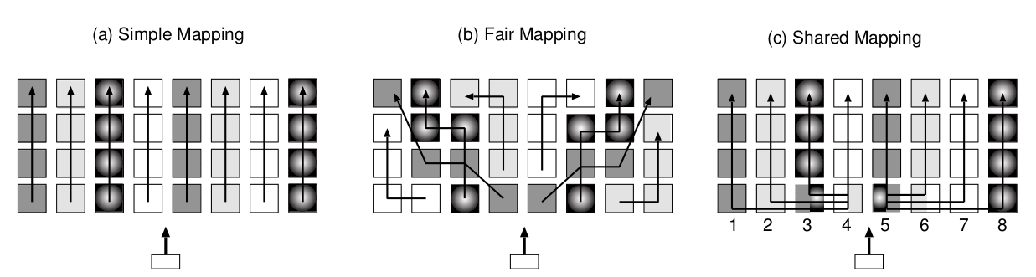
Data Management for NUCA Cache
Mapping: how the data are mapped to the banks.
Eg: distributing ways and sets across banks (D-NUCA).
Searching: how to locate a data block with in the cache.
Eg: incremental , multicast, limited multicast.
Core
Core
(a) Incremental Search
(b) Multicast Search

Slide 7
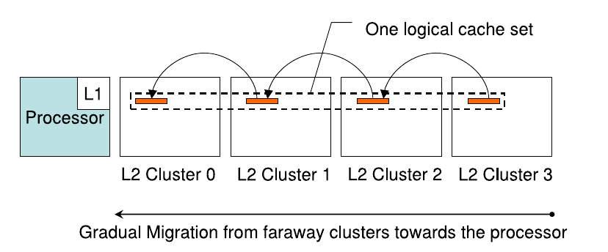
Cont..
Movement: How the data blocks are moved between the cache banks.
Eg: migration.
Motivation :
Because of the migration policy adopted by D-NUCA, data blocks are constantly changing their location to optimize future accesses.
So cache controller don't know the exact location of cache block, hence to search for a block we need to look whole cache (bank-set) in case of miss.
The biggest challenge in searching is to find requested data block in less time, by resulting less traffic messages, and by consuming less power.
“Efficient Search in D-NUCA is an Open Problem [1]”

Slide 8
Baseline Architecture
We assumed similar architecture used in HK-NUCA searching algorithm [3] which is centralized shared CMP.
Core 0
Core 1
Core 2
Core 3
Cluster
Local
Clusters
Bank Set 0
Central
Clusters
Bank Set 1
.
.
.
Local
Clusters
Core 4
Core 5
Core 6
Core 7

Slide 9
Baseline Architecture Cont..
Home Bank : Predetermined based on the home select bits.
Home Function : Which other NUCA banks have at least one of the data blocks and their states that it manages.
To Configure this functionality, every cache block has a state and every cache bank has a set of HKState-NUCA pointer structures (HKState-PTR).
Home Select bits
... | Cluster number | Cache Bank number | Set number | Offset
4 bits
3 bits
7 bits
3 bits
Cluster Bank Set
Address : 1234567
1001 | 0110 | 101 | 1010000 | 111
6
5
80

Slide 10
Baseline Architecture Cont..
Here we are introducing states for each cache block, state represents the movement of the cache block.
Initial state of the cache block is None, which represents up to now there is no movement happens.
If the cache block moved from one cache bank to another its state becomes Moved.
Every cache bank has a set of HKState-PTRs. It has a state section and presence section for each cluster in the cache.
00
None Presence
State Section
Presence Section
01
None State
11
Moved State

Slide 11
Baseline Architecture Cont..
If we have only one bit in state and presence section, we have to check complete set for every update of HKState-PTR.
By maintaining n bits in HKState-PTR for HKSptr-n-way structure we can save n ways corresponding to home bank and their states, so that we can manage updates easily.
n bit
n bit
HKSptr-n-way Structure
1 bit
1 bit
HKSptr-1-way Structure
state
presence
state
presence
None State
Moved State
HKState-PTR
00 | 01 | 00 | 01 | 00 | 11 | 00 | 00 | 11 | 00 | 00 | 00 | 00 | 01 | 11 | 01
00 | 01 | 00 | 01 | 00 | 11 | 00 | 00 | 11 | 00 | 00 | 00 | 00 | 01 | 11 | 01
00 | 01 | 00 | 01 | 00 | 11 | 00 | 00 | 11 | 00 | 00 | 00 | 00 | 01 | 11 | 01
13
13
0
13
0
1
1
2
2
3
3
4
4
5
5
6
6
7
7
8
8
9
9
10
10
11
11
12
12
14
14
15
0
1
2
3
4
5
6
7
8
9
10
11
12
14
15
15
HKState-PTR for HKSptr-1-way Structure

Slide 12
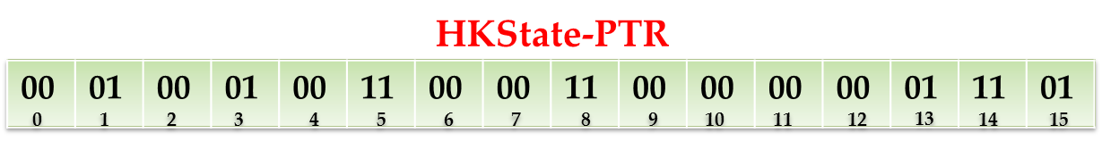
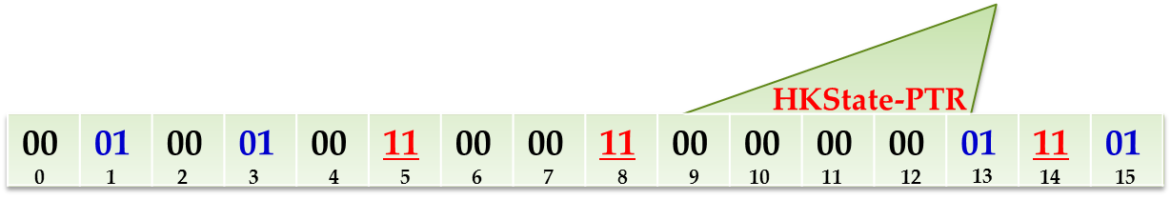
Access Policy
Proposed Algorithm
1. Fast Access : Searching in Local Bank
1. Fast Access : Searching in Local Bank
Off Chip Memory
HKState-NUCA bank access policy consists of four stages.
Fast Access
Call Home
Parallel Access to moved state
Parallel Access to none state
2. Call Home : Searching in Home Bank
Core 0
Core 1
Core 2
Core 0
Core 1
Core 2
Core 3
Core 2
Core 3
0
1
2
3
4
5
6
7
8
9
10
11
12
13
14
15
Core 4
Core 5
Core 6
Core 7
Core 4
Core 5
Core 6
Core 7
3. Parallel Access to Moved States
Initaially Place it in Local Cache Bank
4. Parallel Access to None States

Slide 13
Update Policy
Keeping updated HKState-PTRs is very critical for ensuring accuracy. There are three actions that may arise update in HKState-PTR.
An insertion into a NUCA bank
An eviction from a NUCA bank
A migration movement
If ( Pbit is 0 )
update Pbit to 1
If ( the cache bank does not contain at least one cache block corresponding to home )
Update Pbit to 0
Sbit to 0
If ( we have the space for migrating cache block )
At Source Cache Bank Update like eviction.
At Destination Cache Bank
Update Pbit to 1
Sbit to 1
Else If ( none of the cache blocks corresponding to home is in moved state )
Update Pbit to 1
Sbit to 0
Else – ( we are swapping the blocks )
Swap the states of migrating, victim blocks w.r.t source and destination cache banks
Pbit – Presence bit
Sbit – State bit
Else
Do nothing
Updating corresponding HKState-PTR for HKSptr-1-way Structure

Slide 14
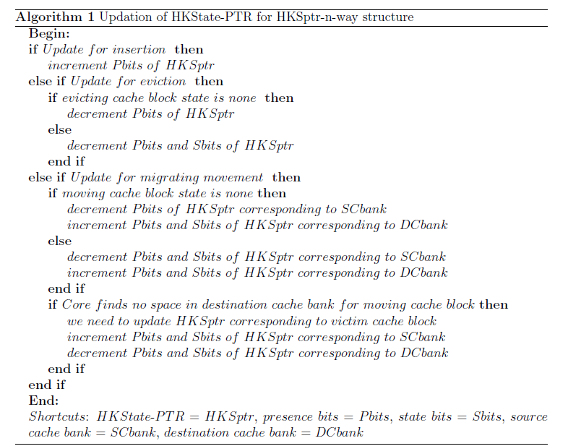
Update Policy Cont..
Algorithm : Update of HKState-PTR for HKSptr-n-way Structure

Slide 15
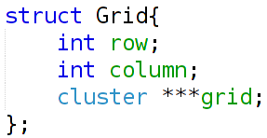
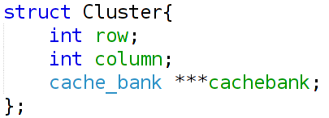
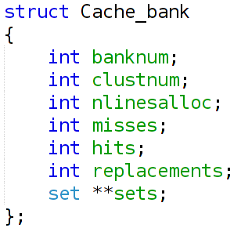
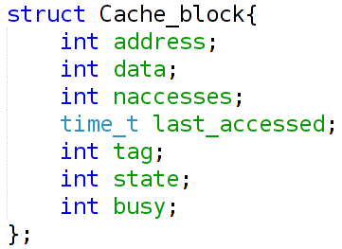
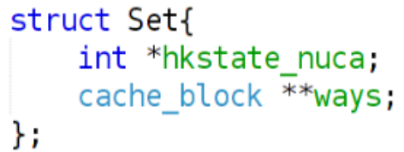
Simulation Setup
We created a virtual standalone simulator called CmpSim in C.
Configuring Cache

Slide 16
Cont..
Configuring Cores :
In CmpSim we have created threads that will act as cores by using pthread library.
Each thread will take addresses from trace file and run Linear Search, HK-NUCA search and HKState-NUCA in parallel.
Dealing with Coherence Problem :
Here we don't have cache coherence protocols, so we are using hash table and we will insert every address under run if that address is not present in the hash table.
If the address is present in the hash table then core will move to busy waiting state (cpu polling).
Dealing with Critical section Problem :
We are using mutex locks to deal with shared sections (critical section). But for cache blocks we are using busy state for that.
Trace file – generated from GEMS simulator for different PARSEC benchmarks [4].

Slide 17
Experimental Results and Analysis
In our experiment we have considered 16 cores, But we explained with 8 core examples for simplification.
We simulated three searching algorithms (including ours) for different benchmarks from PARSEC Suite [4].
Linear Search
HK-NUCA
HKState-NUCA
We already know the fact that HK-NUCA searching algorithm is better compared to all the existing searching algorithms. So we mainly focused on comparing our algorithm with HK-NUCA.
Number of Cores in the system | 16
Cache size | 4 MB, 8 MB
Cache line size | 64 Bytes
Bank set associativity | 32
Bank associativity | 8
Configuration Parameters
Static
2 * (number of core)

Slide 18
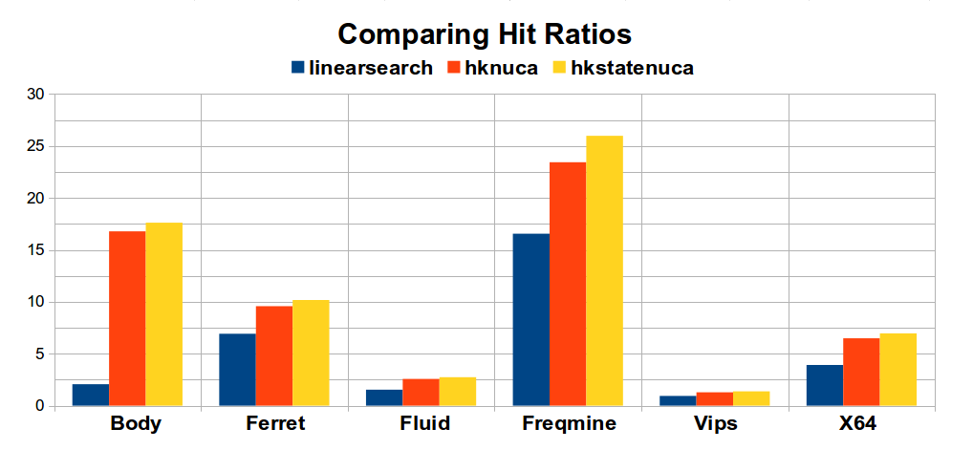
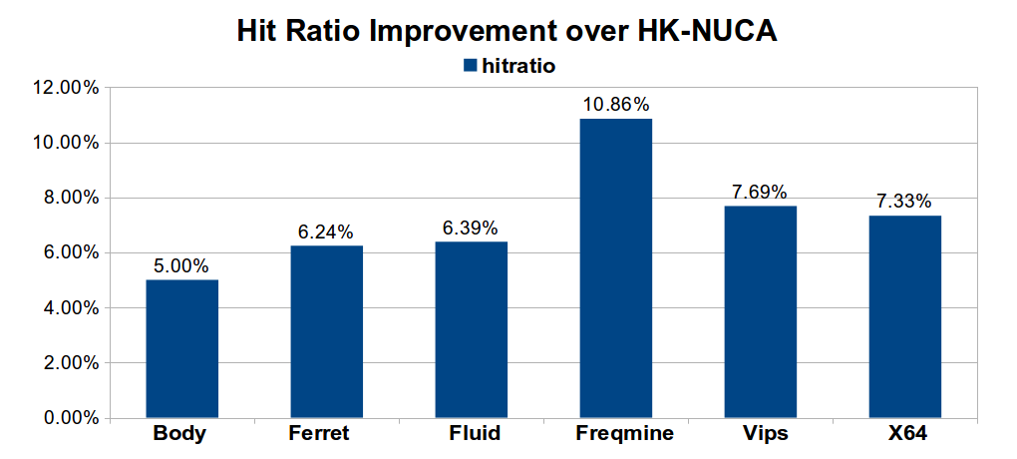
Results and Analysis Cont..
Hit Ratio Comparison :
If we compare hit ratio of HKState-NUCA with HK-NUCA, we got 7.04 % improvement on an average of all the benchmarks we executed.
Hit ratio comparison for Linear search, HK-NUCA, HKState-NUCA
for different benchmarks.
Hit ratio improvement of HKState-NUCA over HK-NUCA,
for different benchmarks.

Slide 19
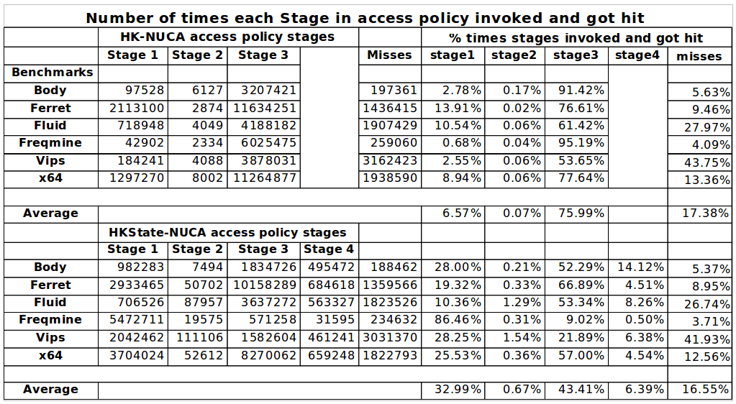
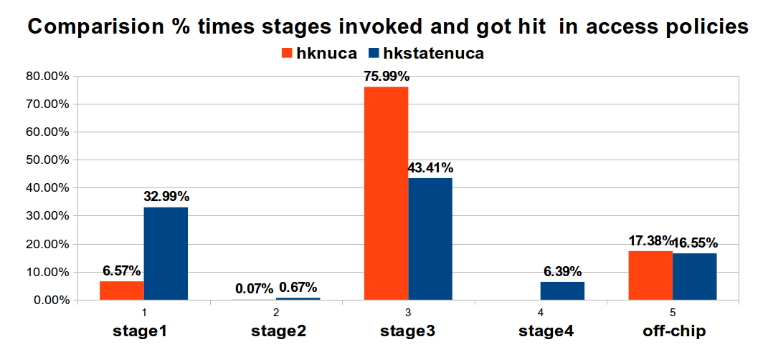
Results and Analysis Cont..
Hit Rate Comparison for each stage in HKState-NUCA and HK-NUCA:
Due to better initial placement we got good hit rate in stage 1.
By using state bit in HKState-NUCA, we are reducing many unnecessary accesses to none state banks in stage 3.
In every access on an average of 87.3% of the time we got hit in the stage 3 of HKState-NUCA access policy compared to stage 4
Number of invocations for each stage in HK-NUCA, HKState-NUCA
Access Policies.
Hit rate Comparison for each stage in HK-NUCA, HKState-NUCA
Access Policies.

Slide 20
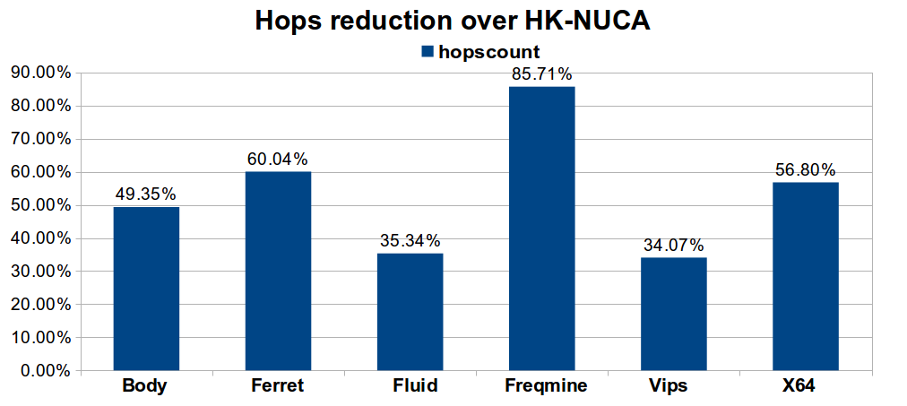
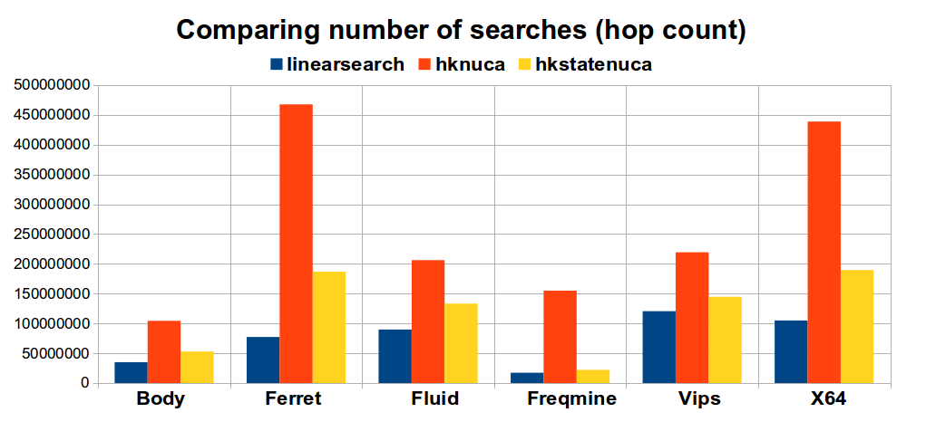
Results and Analysis Cont..
Hop Count Comparison :
If we compare number of searches (hop count) of HKState-NUCA with HK-NUCA, we got 50.89% reduction in searches on an average of all the benchmarks we executed.
We are getting almost 70 % increase in Hop count compared to Linear search.
Why because our algorithm uses multicast search in some stages, where as in linear search when ever core finds a cache block in a cache bank it won't search remaining banks.
Even though Linear Search got less hop count, access time and hit ratio will be very high compared to our algorithm.
Hop count comparison among Linear search, HK-NUCA and HKState-NUCA
for different benchmarks.
Hop count Reduction of HKState-NUCA over HK-NUCA,
for different benchmarks.

Slide 21
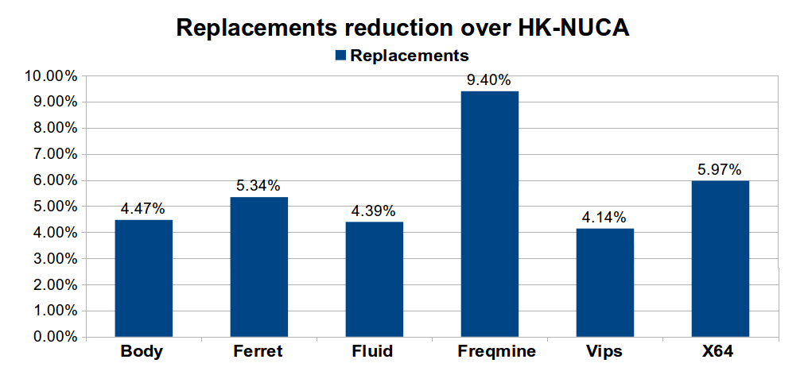
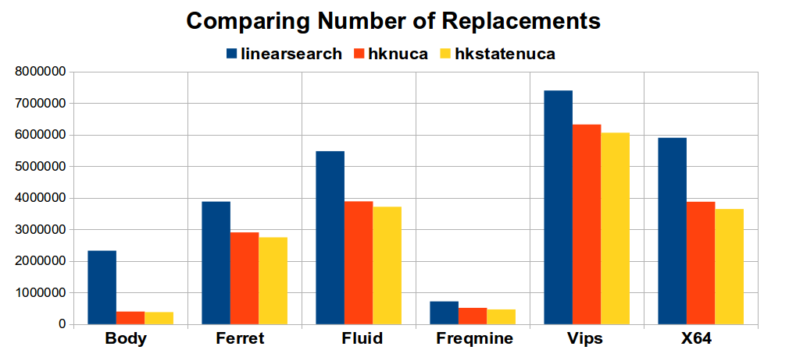
Results and Analysis Cont..
Replacements Comparison :
If we compare number of replacements of HKState-NUCA with HK-NUCA, we got 5.39% reduction in replacements on an average of all the benchmarks we executed.
Replacements reduction of HKState-NUCA over HK-NUCA,
for different benchmarks.
Replacements comparison among Linear search, HK-NUCA, HKState-NUCA
for different benchmarks.

Slide 22
Hardware Overhead
By introducing state section for the HKState-PTR we doubled the overhead compared to HK-NUCA, which is less than 0.8% of hardware or space overhead.
Apart from hardware overhead due to HKState-PTRs, our algorithm introduce some time complexity if we use HKSptr-1-way structure for checking home cache set while updating HKState-PTR.
To overcome this we are introducing HKSptr-n-way structure, which can able to store state and presence for more than one cache block by increasing space overheads by multiple of log(n).
Although our HKState-NUCA algorithm made some small hardware overheads, it will give better performance than HK-NUCA and remaining algorithms in all aspects.

Slide 23
Conclusion
Improvements of HKState-NUCA over HK-NUCA
Due to better initial placement of the cache block nearer to requestor core, we are getting 33 % hit rate in stage 1 itself where as HK-NUCA got 6.57 % hit rate in stage 1.
Reducing number of searches(hops) in case the cache block is found in stage 3, where in stage 3 we are eliminating none state cache banks.
In every access on an average of 87.3 % of the time we got hit in the stage 3 of HKState-NUCA access policy compared to stage 4
Based on the conclusion of the paper [A Novel Migration Based NUCA Design [5]]
First requester is the most frequent requester, that means more than 50 % of the time initial requester is accessing the cache block.
Which proves that the local cache bank is the best initial placement for cache blocks.
Based on the conclusion of the paper [A Novel Migration Based NUCA Design [5]]
On average 87.2 % of the cache lines are private.
Shared lines are used most frequently than the private lines.
Which proves that the reduction in the number of hops due to exempting private cache lines ( none state cache banks ).

Slide 24
Possible Future Prospect
We can separate promoted and demoted states from moved state and find out which states contains more shared lines.
So that we can combine stage 4 with promoted or demoted based on the criteria that state containing less shared lines, which may decreases dynamic energy consumed by the memory system.
But this type of assumptions will be specific to applications.

Slide 25
References
[1] R. Balasubramonian, N. P. Jouppi, and N. Muralimanohar, “Multi-core cache hierarchies”, Synthesis Lectures on Computer Architecture, vol. 6, no. 3, pp. 1-153, 2011.
[2] C. Kim, D. Burger, and S. W. Keckler, “An adaptive, non-uniform cache structure for wire-delay dominated on-chip caches”, in Acm Sigplan Notices, vol. 37, no. 10. ACM, 2002, pp. 211-222.
[3] J. Lira, C. Molina, and A. Gonzalez, “HK-NUCA: Boosting data searches in dynamic non-uniform cache architectures for chip multiprocessors”, in Parallel & Distributed Processing Symposium (IPDPS), 2011 IEEE International. IEEE, 2011, pp. 419-430.
[4] C. Bienia and K. Li, “Parsec 2.0: A new benchmark suite for chip-Multiprocessors”, in Proceedings of the 5th Annual Workshop on Modeling, Benchmarking and Simulation, 2009.
[5] M. Kandemir, F. Li, M. J. Irwin, and S. W. Son, “A Novel migration-based NUCA design for chip multiprocessors”, in High Performance Computing, Networking, Storage and Analysis, 2008. SC 2008. International Conference for. IEEE, 2008, pp. 1-12.

Slide 26
Thank You

Slide 27
Any Queries ???

